Slide 1
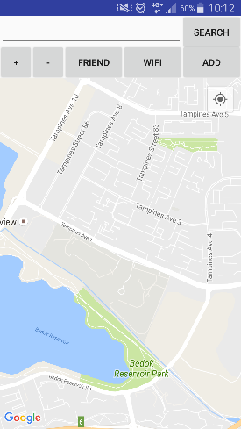
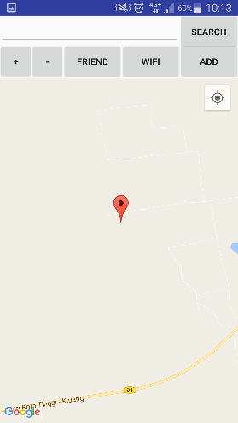

GPS and Wi-Fi Location Tracker
Project No: 1B16412
Main Page of Server App
Able to display location
Project Description
This project was started and created to develop a software application that can help and locate the elderly at anytime. The software application should be able to send GPS information for coordinates and Wi-Fi information if GPS is unavailable.
Using Java programming language, PHP programming language and Android Studio, two different applications were created that uses two different methods. With these applications, they will help users to locate the elderly with GPS and Wi-Fi information.
Key Features
Can display location information on the map
Can detect and display Wi-Fi information in the application
First application uses SMS method to send and receive information
Second application uses OpenShift server to communicate information
Notes:
White Background
Vertical Photo Display

Slide 2
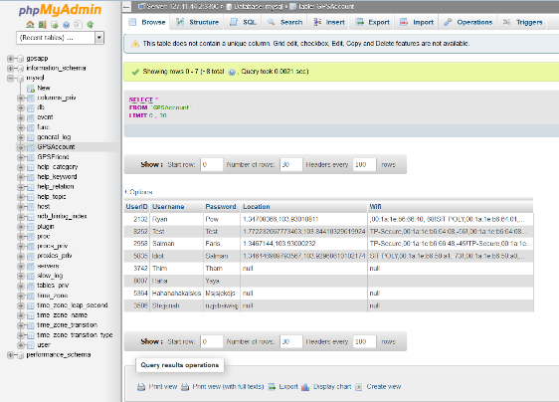
Technical Specifications
Working for Android version 6.0 and below
Requires SIM card for SMS method
Requires Internet for Server method
Request Information
Sending Information
1st Phone
Start
2nd Phone
“Request” Sent
Detect “Request”
“Info” Sent
Read “Info”
End
SMS Method
Phone
Always Updating Info
Request for “User” Info
Receive “User” Info
Server Method
Server
Process Flow
COMPUTER ENGINEERING DIPLOMA UNIT
Students: Pow Rei Young
Supervisor: Mr. Teo Tse Tsong[TP]
Notes:
White Background
Vertical Photo Display

